Slide 1
Sorting Algorithms

Slide 2
Mergesort
Mergesort algorithm is one of two important divide-and-conquer sorting algorithms (the other one is quicksort).
It is a recursive algorithm.
  Divides the list into halves,
  Sort each halve separately, and
  Then merge the sorted halves into one sorted array.

Slide 3
Algorithm
Mergesort(Passed an array)
if array size > 1
Divide array in half
Call Mergesort on first half.
Call Mergesort on second half.
Merge two halves.
Merge(Passed two arrays)
Compare leading element in each array
Select lower and place in new array.
(If one input array is empty then place
remainder of other array in output array)

Slide 4
More TRUTH in CS
We don’t really pass in two arrays!
We pass in one array with indicator variables which tell us where one set of data starts and finishes and where the other set of data starts and finishes.
s1
f1
s2
f2

Slide 5
98
23
45
14
6
67
33
42

Slide 6
98
23
45
14
6
67
33
42
98
23
45
14
6
67
33
42

Slide 7
98
23
45
14
6
67
33
42
98
23
45
14
6
67
33
42
98
23
45
14

Slide 8
98
23
45
14
6
67
33
42
98
23
45
14
6
67
33
42
98
23
45
14
98
23

Slide 9
98
23
45
14
6
67
33
42
98
23
45
14
6
67
33
42
98
23
45
14
98
23
Merge

Slide 10
98
23
45
14
6
67
33
42
98
23
45
14
6
67
33
42
98
23
45
14
98
23
23
Merge

Slide 11
98
23
45
14
6
67
33
42
98
23
45
14
6
67
33
42
98
23
45
14
98
23
23
98
Merge

Slide 12
98
23
45
14
6
67
33
42
98
23
45
14
6
67
33
42
98
23
45
14
98
23
45
14
23
98

Slide 13
98
23
45
14
6
67
33
42
98
23
45
14
6
67
33
42
98
23
45
14
98
23
45
14
23
98
Merge

Slide 14
98
23
45
14
6
67
33
42
98
23
45
14
6
67
33
42
98
23
45
14
98
23
45
14
23
98
14
Merge

Slide 15
98
23
45
14
6
67
33
42
98
23
45
14
6
67
33
42
98
23
45
14
98
23
45
14
23
98
14
45
Merge

Slide 16
98
23
45
14
6
67
33
42
98
23
45
14
6
67
33
42
98
23
45
14
98
23
45
14
23
98
14
45
Merge

Slide 17
98
23
45
14
6
67
33
42
98
23
45
14
6
67
33
42
98
23
45
14
98
23
45
14
23
98
14
45
14
Merge

Slide 18
98
23
45
14
6
67
33
42
98
23
45
14
6
67
33
42
98
23
45
14
98
23
45
14
23
98
14
45
14
23
Merge

Slide 19
98
23
45
14
6
67
33
42
98
23
45
14
6
67
33
42
98
23
45
14
98
23
45
14
23
98
14
45
14
23
45
Merge

Slide 20
98
23
45
14
6
67
33
42
98
23
45
14
6
67
33
42
98
23
45
14
98
23
45
14
23
98
14
45
14
23
45
98
Merge

Slide 21
98
23
45
14
6
67
33
42
98
23
45
14
6
67
33
42
98
23
45
14
6
67
33
42
98
23
45
14
23
98
14
45
14
23
45
98

Slide 22
98
23
45
14
6
67
33
42
98
23
45
14
6
67
33
42
98
23
45
14
6
67
33
42
98
23
45
14
6
67
23
98
14
45
14
23
45
98

Slide 23
98
23
45
14
6
67
33
42
98
23
45
14
6
67
33
42
98
23
45
14
6
67
33
42
98
23
45
14
6
67
23
98
14
45
14
23
45
98
Merge

Slide 24
98
23
45
14
6
67
33
42
98
23
45
14
6
67
33
42
98
23
45
14
6
67
33
42
98
23
45
14
6
67
23
98
14
45
6
14
23
45
98
Merge

Slide 25
98
23
45
14
6
67
33
42
98
23
45
14
6
67
33
42
98
23
45
14
6
67
33
42
98
23
45
14
6
67
23
98
14
45
6
67
14
23
45
98
Merge

Slide 26
98
23
45
14
6
67
33
42
98
23
45
14
6
67
33
42
98
23
45
14
6
67
33
42
98
23
45
14
6
67
33
42
23
98
14
45
6
67
14
23
45
98

Slide 27
98
23
45
14
6
67
33
42
98
23
45
14
6
67
33
42
98
23
45
14
6
67
33
42
98
23
45
14
6
67
33
42
23
98
14
45
6
67
14
23
45
98
Merge

Slide 28
98
23
45
14
6
67
33
42
98
23
45
14
6
67
33
42
98
23
45
14
6
67
33
42
98
23
45
14
6
67
33
42
23
98
14
45
6
67
33
14
23
45
98
Merge

Slide 29
98
23
45
14
6
67
33
42
98
23
45
14
6
67
33
42
98
23
45
14
6
67
33
42
98
23
45
14
6
67
33
42
23
98
14
45
6
67
33
42
14
23
45
98
Merge

Slide 30
98
23
45
14
6
67
33
42
98
23
45
14
6
67
33
42
98
23
45
14
6
67
33
42
98
23
45
14
6
67
33
42
23
98
14
45
6
67
33
42
14
23
45
98
Merge

Slide 31
98
23
45
14
6
67
33
42
98
23
45
14
6
67
33
42
98
23
45
14
6
67
33
42
98
23
45
14
6
67
33
42
23
98
14
45
6
67
33
42
14
23
45
98
6
Merge

Slide 32
98
23
45
14
6
67
33
42
98
23
45
14
6
67
33
42
98
23
45
14
6
67
33
42
98
23
45
14
6
67
33
42
23
98
14
45
6
67
33
42
14
23
45
98
6
33
Merge

Slide 33
98
23
45
14
6
67
33
42
98
23
45
14
6
67
33
42
98
23
45
14
6
67
33
42
98
23
45
14
6
67
33
42
23
98
14
45
6
67
33
42
14
23
45
98
6
33
42
Merge

Slide 34
98
23
45
14
6
67
33
42
98
23
45
14
6
67
33
42
98
23
45
14
6
67
33
42
98
23
45
14
6
67
33
42
23
98
14
45
6
67
33
42
14
23
45
98
6
33
42
67
Merge

Slide 35
98
23
45
14
6
67
33
42
98
23
45
14
6
67
33
42
98
23
45
14
6
67
33
42
98
23
45
14
6
67
33
42
23
98
14
45
6
67
33
42
14
23
45
98
6
33
42
67
Merge

Slide 36
98
23
45
14
6
67
33
42
98
23
45
14
6
67
33
42
98
23
45
14
6
67
33
42
98
23
45
14
6
67
33
42
23
98
14
45
6
67
33
42
14
23
45
98
6
33
42
67
6
Merge

Slide 37
98
23
45
14
6
67
33
42
98
23
45
14
6
67
33
42
98
23
45
14
6
67
33
42
98
23
45
14
6
67
33
42
23
98
14
45
6
67
33
42
14
23
45
98
6
33
42
67
6
14
Merge

Slide 38
98
23
45
14
6
67
33
42
98
23
45
14
6
67
33
42
98
23
45
14
6
67
33
42
98
23
45
14
6
67
33
42
23
98
14
45
6
67
33
42
14
23
45
98
6
33
42
67
6
14
23
Merge

Slide 39
98
23
45
14
6
67
33
42
98
23
45
14
6
67
33
42
98
23
45
14
6
67
33
42
98
23
45
14
6
67
33
42
23
98
14
45
6
67
33
42
14
23
45
98
6
33
42
67
6
14
23
33
Merge

Slide 40
98
23
45
14
6
67
33
42
98
23
45
14
6
67
33
42
98
23
45
14
6
67
33
42
98
23
45
14
6
67
33
42
23
98
14
45
6
67
33
42
14
23
45
98
6
33
42
67
6
14
23
33
42
Merge

Slide 41
98
23
45
14
6
67
33
42
98
23
45
14
6
67
33
42
98
23
45
14
6
67
33
42
98
23
45
14
6
67
33
42
23
98
14
45
6
67
33
42
14
23
45
98
6
33
42
67
6
14
23
33
42
45
Merge

Slide 42
98
23
45
14
6
67
33
42
98
23
45
14
6
67
33
42
98
23
45
14
6
67
33
42
98
23
45
14
6
67
33
42
23
98
14
45
6
67
33
42
14
23
45
98
6
33
42
67
6
14
23
33
42
45
67
Merge

Slide 43
98
23
45
14
6
67
33
42
98
23
45
14
6
67
33
42
98
23
45
14
6
67
33
42
98
23
45
14
6
67
33
42
23
98
14
45
6
67
33
42
14
23
45
98
6
33
42
67
6
14
23
33
42
45
67
98
Merge

Slide 44
98
23
45
14
6
67
33
42
98
23
45
14
6
67
33
42
98
23
45
14
6
67
33
42
98
23
45
14
6
67
33
42
23
98
14
45
6
67
33
42
14
23
45
98
6
33
42
67
6
14
23
33
42
45
67
98

Slide 45
98
23
45
14
6
67
33
42
6
14
23
33
42
45
67
98

Slide 46
Summary
Divide the unsorted collection into two
Until the sub-arrays only contain one element
Then merge the sub-problem solutions together

Slide 47
Algorithm
Mergesort(Passed an array)
if array size > 1
Divide array in half
Call Mergesort on first half.
Call Mergesort on second half.
Merge two halves.
Merge(Passed two arrays)
Compare leading element in each array
Select lower and place in new array.
(If one input array is empty then place
remainder of other array in output array)

Slide 48
Merge
const int MAX_SIZE = maximum-number-of-items-in-array;
void merge(DataType theArray[], int first, int mid, int last) {
DataType tempArray[MAX_SIZE]; // temporary array
int first1 = first; // beginning of first subarray
int last1 = mid; // end of first subarray
int first2 = mid + 1; // beginning of second subarray
int last2 = last; // end of second subarray
int index = first1; // next available location in tempArray
for ( ; (first1 <= last1) && (first2 <= last2); ++index) {
if (theArray[first1] < theArray[first2]) {
tempArray[index] = theArray[first1];
++first1;
}
else {
tempArray[index] = theArray[first2];
++first2;
} }

Slide 49
Merge (cont.)
// finish off the first subarray, if necessary
for (; first1 <= last1; ++first1, ++index)
tempArray[index] = theArray[first1];
// finish off the second subarray, if necessary
for (; first2 <= last2; ++first2, ++index)
tempArray[index] = theArray[first2];
// copy the result back into the original array
for (index = first; index <= last; ++index)
theArray[index] = tempArray[index];
} // end merge

Slide 50
Mergesort
void mergesort(DataType theArray[], int first, int last) {
if (first < last) {
int mid = (first + last)/2; // index of midpoint
mergesort(theArray, first, mid);
mergesort(theArray, mid+1, last);
// merge the two halves
merge(theArray, first, mid, last);
}
} // end mergesort

Slide 51
Mergesort – Analysis of Merge
0 k-1
0 k-1
Merging two sorted arrays of size k
Best-case:
  All the elements in the first array are smaller (or larger) than all the elements in the second array.
  The number of moves: 2k + 2k
  The number of key comparisons: k
Worst-case:
  The number of moves: 2k + 2k
  The number of key comparisons: 2k-1
 | ......
 | ......
0 2k-1
 | ......

Slide 52
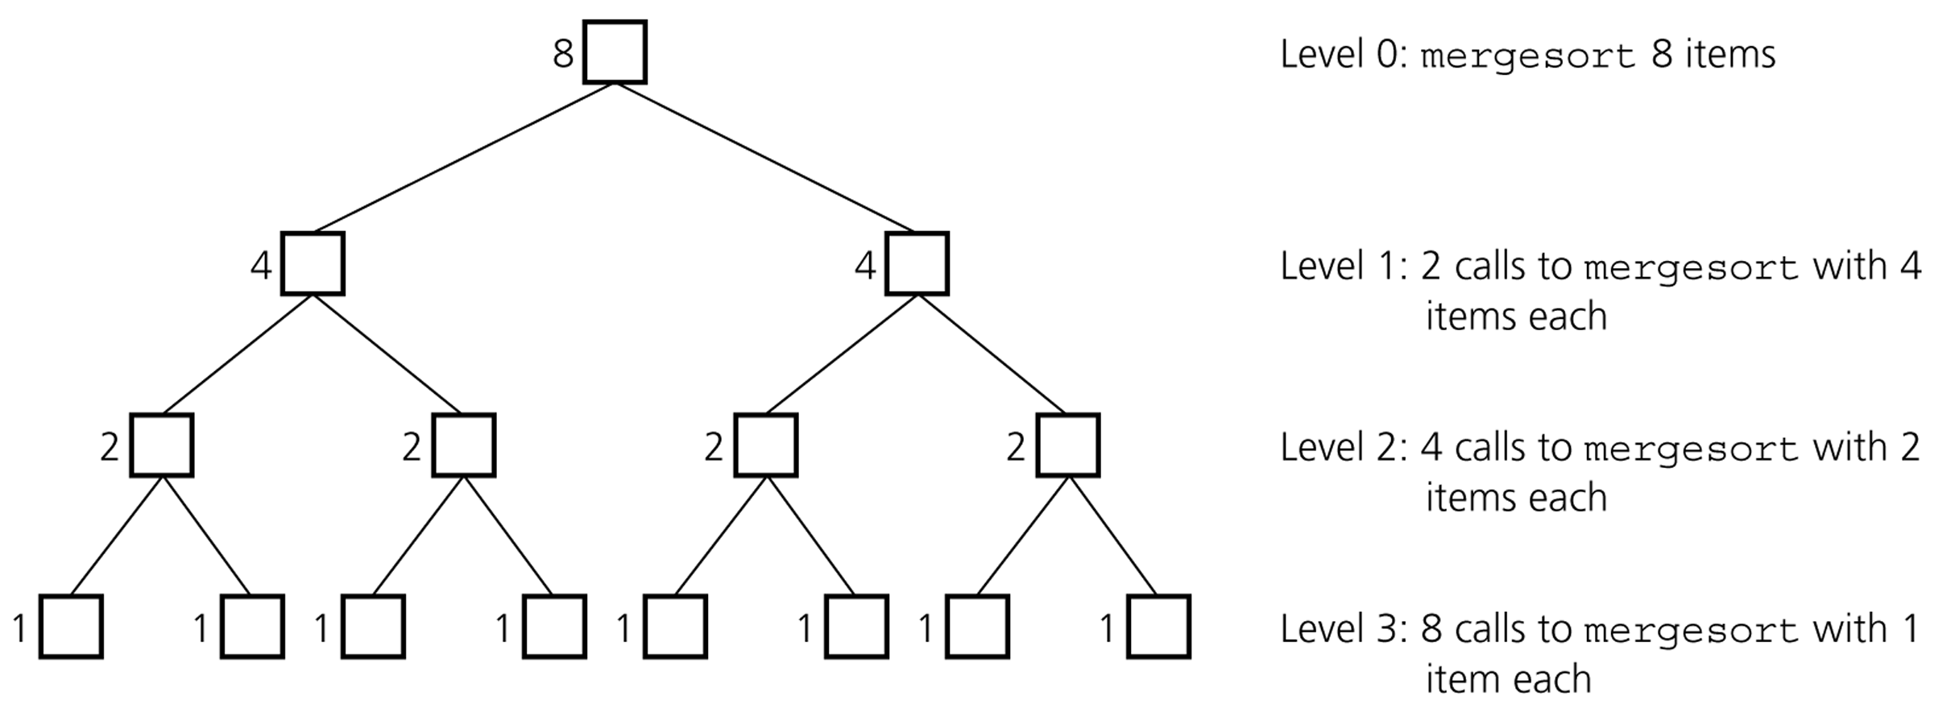
Mergesort - Analysis
Levels of recursive calls to mergesort, given an array of eight items

Slide 53
Mergesort - Analysis
2^{m}
level 0 : 1 merge (size 2^{m-1})
2^{m-1}
2^{m-1}
level 1 : 2 merges (size 2^{m-2})
level 2 : 4 merges (size 2^{m-3})
2^{m-2}
2^{m-2}
2^{m-2}
2^{m-2}
.
.
.
.
.
.
level m-1 : 2^{m-1} merges (size 2⁰)
2⁰
2⁰
. . . . . . . . . . . . . . . . .
level m

Slide 54
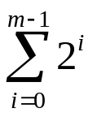
Mergesort - Analysis
Worst-case –
The number of key comparisons:
= 2⁰*(2*2^{m-1}-1) + 2¹*(2*2^{m-2}-1) + ... + 2^{m-1}*(2*2⁰-1)
= (2^{m} - 1) + (2^{m} - 2) + ... + (2^{m} – 2^{m-1}) ( m terms )
= m*2^{m} –
= m*2^{m} – 2^{m} – 1
Using m = log n
= n * log₂n – n – 1
➔ O (n * log₂n )

Slide 55
Mergesort – Analysis
Mergesort is extremely efficient algorithm with respect to time.
  Both worst case and average cases are O (n * log₂n )
But, mergesort requires an extra array whose size equals to the size of the original array.
If we use a linked list, we do not need an extra array
  But, we need space for the links
  And, it will be difficult to divide the list into half ( O(n) )

Slide 56
Quicksort
Like mergesort, Quicksort is also based on
the divide-and-conquer paradigm.
But it uses this technique in a somewhat opposite manner,
as all the hard work is done before the recursive calls.
It works as follows:
  First, it partitions an array into two parts,
  Then, it sorts the parts independently,
  Finally, it combines the sorted subsequences by
  a simple concatenation.

Slide 57
Quicksort (cont.)
The quick-sort algorithm consists of the following three steps:
1. Divide: Partition the list.
  To partition the list, we first choose some element from the list for which we hope about half the elements will come before and half after. Call this element the pivot.
  Then we partition the elements so that all those with values less than the pivot come in one sublist and all those with greater values come in another.
2. Recursion: Recursively sort the sublists separately.
3. Conquer: Put the sorted sublists together.

Slide 58
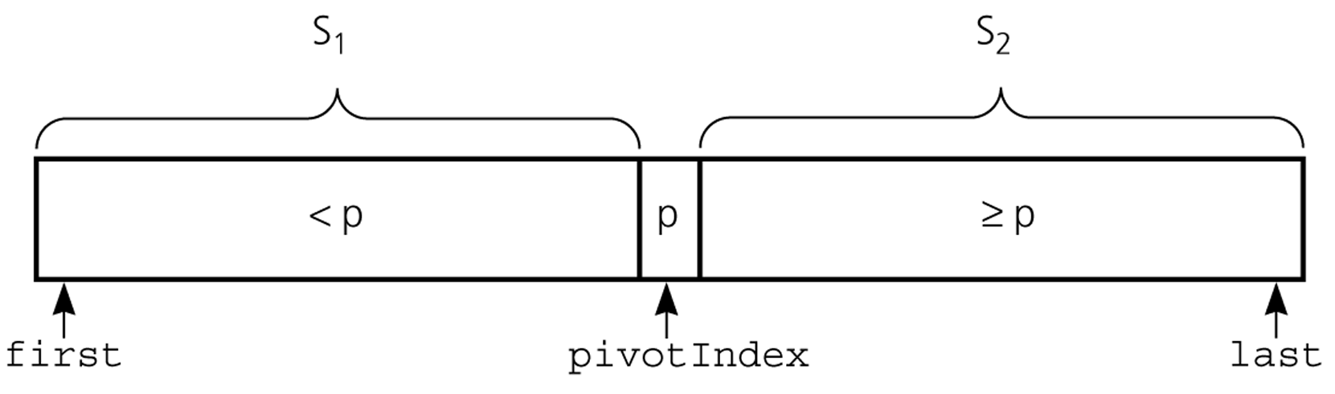
Partition
Partitioning places the pivot in its correct place position within the array.
Arranging the array elements around the pivot p generates two smaller sorting problems.
  sort the left section of the array, and sort the right section of the array.
  when these two smaller sorting problems are solved recursively, our bigger sorting problem is solved.

Slide 59
Quicksort Algorithm
Given an array of n elements (e.g., integers):
If array only contains one element, return
Else
  pick one element to use as pivot.
  Partition elements into two sub-arrays:
    Elements less than or equal to pivot
    Elements greater than pivot
  Quicksort two sub-arrays
  Return results

Slide 60
Example
We are given array of n integers to sort:
40
20
10
80
60
50
7
30
100

Slide 61
Pick Pivot Element
There are a number of ways to pick the pivot element. In this example, we will use the first element in the array:
40
20
10
80
60
50
7
30
100

Slide 62
Partitioning Array
Given a pivot, partition the elements of the array such that the resulting array consists of:
  One sub-array that contains elements >= pivot
  Another sub-array that contains elements < pivot
The sub-arrays are stored in the original data array.
Partitioning loops through, swapping elements below/above pivot.

Slide 63
pivot_index = 0
40
20
10
80
60
50
7
30
100
[0] [1] [2] [3] [4] [5] [6] [7] [8]
i
j

Slide 64
While data[i] <= data[pivot]
++i
pivot_index = 0
40
20
10
80
60
50
7
30
100
[0] [1] [2] [3] [4] [5] [6] [7] [8]
i
j

Slide 65
While data[i] <= data[pivot]
++i
pivot_index = 0
40
20
10
80
60
50
7
30
100
[0] [1] [2] [3] [4] [5] [6] [7] [8]
i
j

Slide 66
While data[i] <= data[pivot]
++i
pivot_index = 0
40
20
10
80
60
50
7
30
100
[0] [1] [2] [3] [4] [5] [6] [7] [8]
i
j

Slide 67
While data[i] <= data[pivot]
  ++i
While data[j] > data[pivot]
  --j
pivot_index = 0
40
20
10
80
60
50
7
30
100
[0] [1] [2] [3] [4] [5] [6] [7] [8]
i
j

Slide 68
While data[i] <= data[pivot]
  ++i
While data[j] > data[pivot]
  --j
pivot_index = 0
40
20
10
80
60
50
7
30
100
[0] [1] [2] [3] [4] [5] [6] [7] [8]
i
j

Slide 69
While data[i] <= data[pivot]
  ++i
While data[j] > data[pivot]
  --j
If i < j
  swap data[i] and data[j]
pivot_index = 0
40
20
10
80
60
50
7
30
100
[0] [1] [2] [3] [4] [5] [6] [7] [8]
i
j

Slide 70
While data[i] <= data[pivot]
  ++i
While data[j] > data[pivot]
  --j
If i < j
  swap data[i] and data[j]
pivot_index = 0
40
20
10
30
60
50
7
80
100
[0] [1] [2] [3] [4] [5] [6] [7] [8]
i
j

Slide 71
While data[i] <= data[pivot]
  ++i
While data[j] > data[pivot]
  --j
If i < j
  swap data[i] and data[j]
While j > i, go to 1.
pivot_index = 0
40
20
10
30
60
50
7
80
100
[0] [1] [2] [3] [4] [5] [6] [7] [8]
i
j

Slide 72
While data[i] <= data[pivot]
  ++i
While data[j] > data[pivot]
  --j
If i < j
  swap data[i] and data[j]
While j > i, go to 1.
pivot_index = 0
40
20
10
30
60
50
7
80
100
[0] [1] [2] [3] [4] [5] [6] [7] [8]
i
j

Slide 73
While data[i] <= data[pivot]
  ++i
While data[j] > data[pivot]
  --j
If i < j
  swap data[i] and data[j]
While j > i, go to 1.
pivot_index = 0
40
20
10
30
60
50
7
80
100
[0] [1] [2] [3] [4] [5] [6] [7] [8]
i
j

Slide 74
While data[i] <= data[pivot]
  ++i
While data[j] > data[pivot]
  --j
If i < j
  swap data[i] and data[j]
While j > i, go to 1.
pivot_index = 0
40
20
10
30
60
50
7
80
100
[0] [1] [2] [3] [4] [5] [6] [7] [8]
i
j

Slide 75
While data[i] <= data[pivot]
  ++i
While data[j] > data[pivot]
  --j
If i < j
  swap data[i] and data[j]
While j > i, go to 1.
pivot_index = 0
40
20
10
30
60
50
7
80
100
[0] [1] [2] [3] [4] [5] [6] [7] [8]
i
j

Slide 76
While data[i] <= data[pivot]
  ++i
While data[j] > data[pivot]
  --j
If i < j
  swap data[i] and data[j]
While j > i, go to 1.
pivot_index = 0
40
20
10
30
60
50
7
80
100
[0] [1] [2] [3] [4] [5] [6] [7] [8]
i
j

Slide 77
While data[i] <= data[pivot]
  ++i
While data[j] > data[pivot]
  --j
If i < j
  swap data[i] and data[j]
While j > i, go to 1.
pivot_index = 0
40
20
10
30
7
50
60
80
100
[0] [1] [2] [3] [4] [5] [6] [7] [8]
i
j

Slide 78
While data[i] <= data[pivot]
  ++i
While data[j] > data[pivot]
  --j
If i < j
  swap data[i] and data[j]
While j > i, go to 1.
pivot_index = 0
40
20
10
30
7
50
60
80
100
[0] [1] [2] [3] [4] [5] [6] [7] [8]
i
j

Slide 79
While data[i] <= data[pivot]
  ++i
While data[j] > data[pivot]
  --j
If i < j
  swap data[i] and data[j]
While j > i, go to 1.
pivot_index = 0
40
20
10
30
7
50
60
80
100
[0] [1] [2] [3] [4] [5] [6] [7] [8]
i
j

Slide 80
While data[i] <= data[pivot]
  ++i
While data[j] > data[pivot]
  --j
If i < j
  swap data[i] and data[j]
While j > i, go to 1.
pivot_index = 0
40
20
10
30
7
50
60
80
100
[0] [1] [2] [3] [4] [5] [6] [7] [8]
i
j

Slide 81
While data[i] <= data[pivot]
  ++i
While data[j] > data[pivot]
  --j
If i < j
  swap data[i] and data[j]
While j > i, go to 1.
pivot_index = 0
40
20
10
30
7
50
60
80
100
[0] [1] [2] [3] [4] [5] [6] [7] [8]
i
j

Slide 82
While data[i] <= data[pivot]
  ++i
While data[j] > data[pivot]
  --j
If i < j
  swap data[i] and data[j]
While j > i, go to 1.
pivot_index = 0
40
20
10
30
7
50
60
80
100
[0] [1] [2] [3] [4] [5] [6] [7] [8]
i
j

Slide 83
While data[i] <= data[pivot]
  ++i
While data[j] > data[pivot]
  --j
If i < j
  swap data[i] and data[j]
While j > i, go to 1.
pivot_index = 0
40
20
10
30
7
50
60
80
100
[0] [1] [2] [3] [4] [5] [6] [7] [8]
i
j

Slide 84
While data[i] <= data[pivot]
  ++i
While data[j] > data[pivot]
  --j
If i < j
  swap data[i] and data[j]
While j > i, go to 1.
pivot_index = 0
40
20
10
30
7
50
60
80
100
[0] [1] [2] [3] [4] [5] [6] [7] [8]
i
j

Slide 85
While data[i] <= data[pivot]
  ++i
While data[j] > data[pivot]
  --j
If i < j
  swap data[i] and data[j]
While j > i, go to 1.
pivot_index = 0
40
20
10
30
7
50
60
80
100
[0] [1] [2] [3] [4] [5] [6] [7] [8]
i
j

Slide 86
While data[i] <= data[pivot]
  ++i
While data[j] > data[pivot]
  --j
If i < j
  swap data[i] and data[j]
While j > i, go to 1.
Swap data[j] and data[pivot_index]
pivot_index = 0
40
20
10
30
7
50
60
80
100
[0] [1] [2] [3] [4] [5] [6] [7] [8]
i
j

Slide 87
While data[i] <= data[pivot]
  ++i
While data[j] > data[pivot]
  --j
If i < j
  swap data[i] and data[j]
While j > i, go to 1.
Swap data[j] and data[pivot_index]
7
20
10
30
40
50
60
80
100
pivot_index = 4
[0] [1] [2] [3] [4] [5] [6] [7] [8]
i
j

Slide 88
Partition Result
7
20
10
30
40
50
60
80
100
[0] [1] [2] [3] [4] [5] [6] [7] [8]
<= data[pivot]
> data[pivot]

Slide 89
Recursion: Quicksort Sub-arrays
7
20
10
30
40
50
60
80
100
[0] [1] [2] [3] [4] [5] [6] [7] [8]
<= data[pivot]
> data[pivot]

Slide 90
Quicksort Analysis
Assume that keys are random, uniformly distributed.
What is best case running time?

Slide 91
Quicksort Analysis
Assume that keys are random, uniformly distributed.
What is best case running time?
  Recursion:
    Partition splits array in two sub-arrays of size n/2
    Quicksort each sub-array

Slide 92
Quicksort Analysis
Assume that keys are random, uniformly distributed.
What is best case running time?
  Recursion:
    Partition splits array in two sub-arrays of size n/2
    Quicksort each sub-array
  Depth of recursion tree?

Slide 93
Quicksort Analysis
Assume that keys are random, uniformly distributed.
What is best case running time?
  Recursion:
    Partition splits array in two sub-arrays of size n/2
    Quicksort each sub-array
  Depth of recursion tree? O(log₂n)

Slide 94
Quicksort Analysis
Assume that keys are random, uniformly distributed.
What is best case running time?
  Recursion:
    Partition splits array in two sub-arrays of size n/2
    Quicksort each sub-array
  Depth of recursion tree? O(log₂n)
  Number of accesses in partition?

Slide 95
Quicksort Analysis
Assume that keys are random, uniformly distributed.
What is best case running time?
  Recursion:
    Partition splits array in two sub-arrays of size n/2
    Quicksort each sub-array
  Depth of recursion tree? O(log₂n)
  Number of accesses in partition? O(n)

Slide 96
Quicksort Analysis
Assume that keys are random, uniformly distributed.
Best case running time: O(n log₂n)

Slide 97
Quicksort Analysis
Assume that keys are random, uniformly distributed.
Best case running time: O(n log₂n)
Worst case running time?

Slide 98
Quicksort: Worst Case
Assume first element is chosen as pivot.
Assume we get array that is already in order:
pivot_index = 0
2
4
10
12
13
50
57
63
100
[0] [1] [2] [3] [4] [5] [6] [7] [8]
i
j

Slide 99
While data[i] <= data[pivot]
  ++i
While data[j] > data[pivot]
  --j
If i < j
  swap data[i] and data[j]
While j > i, go to 1.
Swap data[j] and data[pivot_index]
pivot_index = 0
2
4
10
12
13
50
57
63
100
[0] [1] [2] [3] [4] [5] [6] [7] [8]
i
j

Slide 100
While data[i] <= data[pivot]
  ++i
While data[j] > data[pivot]
  --j
If i < j
  swap data[i] and data[j]
While j > i, go to 1.
Swap data[j] and data[pivot_index]
pivot_index = 0
2
4
10
12
13
50
57
63
100
[0] [1] [2] [3] [4] [5] [6] [7] [8]
i
j

Slide 101
While data[i] <= data[pivot]
  ++i
While data[j] > data[pivot]
  --j
If i < j
  swap data[i] and data[j]
While j > i, go to 1.
Swap data[j] and data[pivot_index]
pivot_index = 0
2
4
10
12
13
50
57
63
100
[0] [1] [2] [3] [4] [5] [6] [7] [8]
i
j

Slide 102
While data[i] <= data[pivot]
  ++i
While data[j] > data[pivot]
  --j
If i < j
  swap data[i] and data[j]
While j > i, go to 1.
Swap data[j] and data[pivot_index]
pivot_index = 0
2
4
10
12
13
50
57
63
100
[0] [1] [2] [3] [4] [5] [6] [7] [8]
i
j

Slide 103
While data[i] <= data[pivot]
  ++i
While data[j] > data[pivot]
  --j
If i < j
  swap data[i] and data[j]
While j > i, go to 1.
Swap data[j] and data[pivot_index]
pivot_index = 0
2
4
10
12
13
50
57
63
100
[0] [1] [2] [3] [4] [5] [6] [7] [8]
i
j

Slide 104
While data[i] <= data[pivot]
  ++i
While data[j] > data[pivot]
  --j
If i < j
  swap data[i] and data[j]
While j > i, go to 1.
Swap data[j] and data[pivot_index]
pivot_index = 0
2
4
10
12
13
50
57
63
100
[0] [1] [2] [3] [4] [5] [6] [7] [8]
i
j

Slide 105
While data[i] <= data[pivot]
  ++i
While data[j] > data[pivot]
  --j
If i < j
  swap data[i] and data[j]
While j > i, go to 1.
Swap data[j] and data[pivot_index]
pivot_index = 0
2
4
10
12
13
50
57
63
100
[0] [1] [2] [3] [4] [5] [6] [7] [8]
<= data[pivot]
> data[pivot]

Slide 106
Quicksort Analysis
Assume that keys are random, uniformly distributed.
Best case running time: O(n log₂n)
Worst case running time?
  Recursion:
    Partition splits array in two sub-arrays:
      one sub-array of size 0
      the other sub-array of size n-1
    Quicksort each sub-array
  Depth of recursion tree?

Slide 107
Quicksort Analysis
Assume that keys are random, uniformly distributed.
Best case running time: O(n log₂n)
Worst case running time?
  Recursion:
    Partition splits array in two sub-arrays:
      one sub-array of size 0
      the other sub-array of size n-1
    Quicksort each sub-array
  Depth of recursion tree? O(n)

Slide 108
Quicksort Analysis
Assume that keys are random, uniformly distributed.
Best case running time: O(n log₂n)
Worst case running time?
  Recursion:
    Partition splits array in two sub-arrays:
      one sub-array of size 0
      the other sub-array of size n-1
    Quicksort each sub-array
  Depth of recursion tree? O(n)
  Number of accesses per partition?

Slide 109
Quicksort Analysis
Assume that keys are random, uniformly distributed.
Best case running time: O(n log₂n)
Worst case running time?
  Recursion:
    Partition splits array in two sub-arrays:
      one sub-array of size 0
      the other sub-array of size n-1
    Quicksort each sub-array
  Depth of recursion tree? O(n)
  Number of accesses per partition? O(n)

Slide 110
Quicksort Analysis
Assume that keys are random, uniformly distributed.
Best case running time: O(n log₂n)
Worst case running time: O(n²)!!!

Slide 111
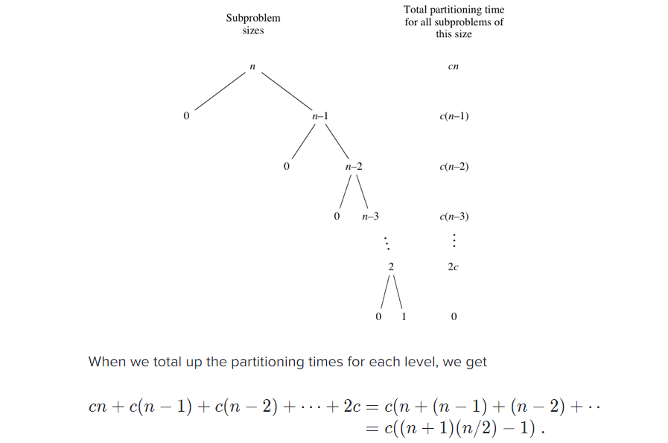

Slide 112
Quicksort Analysis
Assume that keys are random, uniformly distributed.
Best case running time: O(n log₂n)
Worst case running time: O(n²)!!!
What can we do to avoid worst case?

Slide 113
Improved Pivot Selection
Pick median value of three elements from data array:
data[0], data[n/2], and data[n-1].
Use this median value as pivot.

Slide 114
Improving Performance of Quicksort
Improved selection of pivot.
For sub-arrays of size 3 or less, apply brute force search:
  Sub-array of size 1: trivial
  Sub-array of size 2:
    if(data[first] > data[second]) swap them
  Sub-array of size 3: left as an exercise.

Slide 115
Partition – Choosing the pivot
First, we have to select a pivot element among the elements of the given array, and we put this pivot into the first location of the array before partitioning.
Which array item should be selected as pivot?
  Somehow we have to select a pivot, and we hope that we will get a good partitioning.
  If the items in the array arranged randomly, we choose a pivot randomly.
  We can choose the first or last element as a pivot (it may not give a good partitioning).
  We can use different techniques to select the pivot.

Slide 116
Partition Function
void partition(DataType theArray[], int first, int last,
int &pivotIndex) {
// Partitions an array for quicksort.
// Precondition: first <= last.
// Postcondition: Partitions theArray[first..last] such that:
// S1 = theArray[first..pivotIndex-1] < pivot
// theArray[pivotIndex] == pivot
// S2 = theArray[pivotIndex+1..last] >= pivot
// Calls: choosePivot and swap.
// place pivot in theArray[first]
choosePivot(theArray, first, last);
DataType pivot = theArray[first]; // copy pivot

Slide 117
Partition Function (cont.)
// initially, everything but pivot is in unknown
int lastS1 = first; // index of last item in S1
int firstUnknown = first + 1; //index of 1st item in unknown
// move one item at a time until unknown region is empty
for (; firstUnknown <= last; ++firstUnknown) {
// Invariant: theArray[first+1..lastS1] < pivot
// theArray[lastS1+1..firstUnknown-1] >= pivot
// move item from unknown to proper region
if (theArray[firstUnknown] < pivot) { // belongs to S1
++lastS1;
swap(theArray[firstUnknown], theArray[lastS1]);
} // else belongs to S2
}
// place pivot in proper position and mark its location
swap(theArray[first], theArray[lastS1]);
pivotIndex = lastS1;
} // end partition

Slide 118
Quicksort Function
void quicksort(DataType theArray[], int first, int last) {
// Sorts the items in an array into ascending order.
// Precondition: theArray[first..last] is an array.
// Postcondition: theArray[first..last] is sorted.
// Calls: partition.
int pivotIndex;
if (first < last) {
// create the partition: S1, pivot, S2
partition(theArray, first, last, pivotIndex);
// sort regions S1 and S2
quicksort(theArray, first, pivotIndex-1);
quicksort(theArray, pivotIndex+1, last);
}
}

Slide 119
Quicksort – Analysis
Quicksort is O(n*log₂n) in the best case and average case.
Quicksort is slow when the array is sorted and we choose the first element as the pivot.
Although the worst case behavior is not so good, its average case behavior is much better than its worst case.
  So, Quicksort is one of best sorting algorithms using key comparisons.

Slide 120
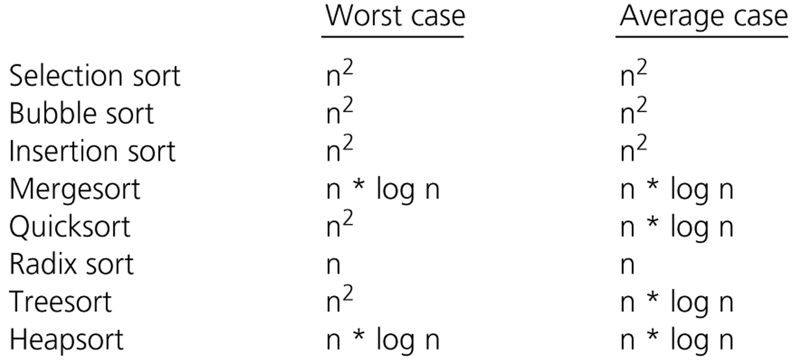
Comparison of Sorting Algorithms

